Slide 2
The Call for Action – We Answered
Our History
Women Veterans Support Services, Inc. (WVSS) was established in 2008 and has the distinction of being the State of North Carolina's First Women Veteran organization. This nonprofit 501 (c) 3 has provided services to over 1000 women veterans with or without families and counting. We started with an all-volunteer staff. WVSS, Inc. specializes in crisis management.
Our Core Values
Honor – She served
Dignity – Take back your control
Compassion- Listen, empathize
Advocacy – Giving our voice

Slide 3
About Us
Mission:
The Women Veterans Support Services (WVSS) mission is to provide compassionate care to women veterans in times of crisis, ensure they receive the benefits to which they and their families are entitled and connect them to community support. We also advocate on issues affecting women veterans. Our service is not only locally but beyond the local boundaries.
Vision:
WVSS vision is that we will provide a beacon of hope to women veterans in crisis. Through our services, these women and their families will have their dignity restored and will be empowered to take positive steps to move forward in their lives. This vision is to be fostered with the creation of the Deborah Center.

Slide 4
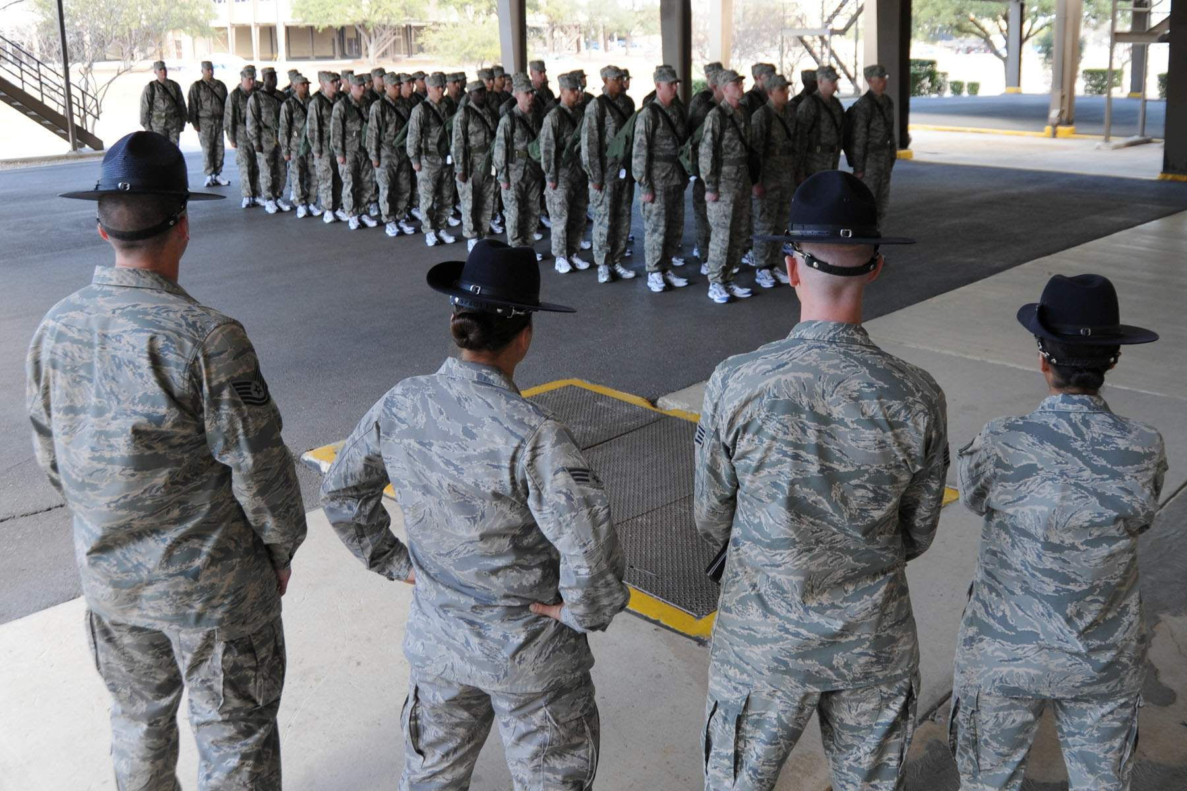
Women Veterans: The Underserved
The Red Shoes Experience
This Photo by Unknown Author is licensed under CC BY-SA

Slide 5
The Red Shoes Experience….Four Programs
Red Shoe, our original shoe program addresses the Homeless and crisis for woman veterans.
Protective Red Shoe, which is our new Federally funded pilot Program that addresses Domestic Violence and Sexual Assault among our active duty and veterans.
H.E.R. Redefined, which addresses the total woman recovery and two support groups a) women military/veterans b) military spouses (teleconferenced with workbooks).
Ready4Work, assists with job preparation, job placement.

Slide 6
Thank you!
No matter what your footgear is, come to us in crisis for direct support or referrals we have it here to support.
If you need us and can’t talk, then text us @ 919-696-9572
We operate from donations, grants and in-kind. No salaries are paid by donations, they only support the programs.
You can donate today by cash.app to $wvssncredshoe
Contact me by email p.harris@wvss-nc.org Patricia A Harris
Visit us on Facebook

